Slide 1
Loading and Visualizing COVID-19 Data
Team Locode

Slide 2
Authentication and Schema – REST API

Slide 3
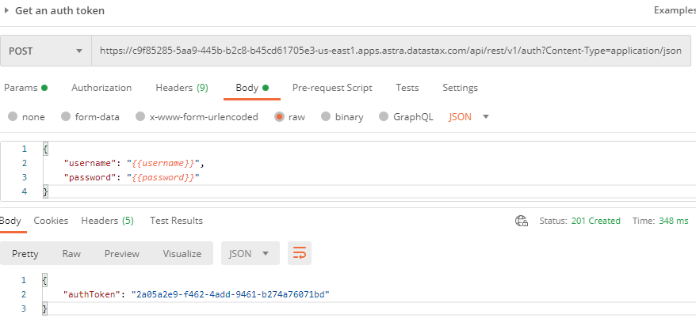
Postman: Get an auth token

Slide 4
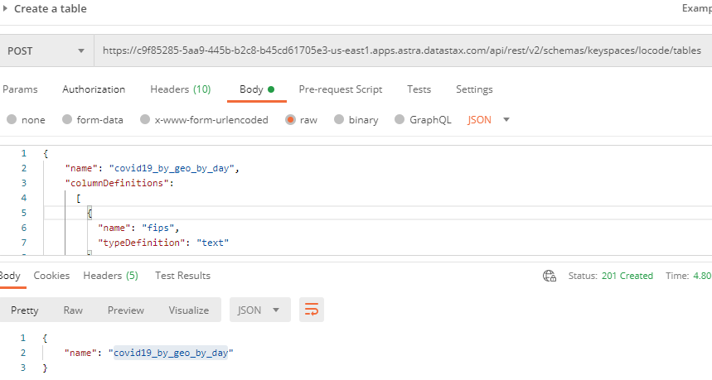
Postman: Create a table

Slide 5
Load Data – dsbulk

Slide 6
Windows Command Line: dsbulk for initial loading
dsbulk load ^
-url https://raw.githubusercontent.com/CSSEGISandData/COVID-19/master/csse_covid_19_data/csse_covid_19_daily_reports/03-31-2020.csv ^
-k locode ^
-t covid19_by_geo_by_day ^
-b "C://DataStax//secure-connect//secure-connect-locodedb.zip" ^
-u <username> ^
-p <password> ^
-header true ^
-m "FIPS=fips,Admin2=admin2,Province_State=province_state,Country_Region=country_region,Last_Update=last_update, Lat=lat,Long_=long_,Confirmed=confirmed,Deaths=deaths,Recovered=recovered,Active=active,Combined_Key=combined_key"
Username and password provided but auth provider not specified, inferring PlainTextAuthProvider
A cloud secure connect bundle was provided: ignoring all explicit contact points.
A cloud secure connect bundle was provided and selected operation performs writes: changing default consistency level to LOCAL_QUORUM.
Operation directory: C:\DataStax\dsbulk-1.7.0\bin\logs\LOAD_20201012-193450-056000
total | failed | rows/s | p50ms | p99ms | p999ms | batches
2,434 | 0 | 843 | 1,053.55 | 1,174.41 | 1,174.41 | 9.55
Operation LOAD_20201012-193450-056000 completed successfully in 1 second.
Last processed positions can be found in positions.txt

Slide 7
Test Loaded Data – REST API

Slide 8
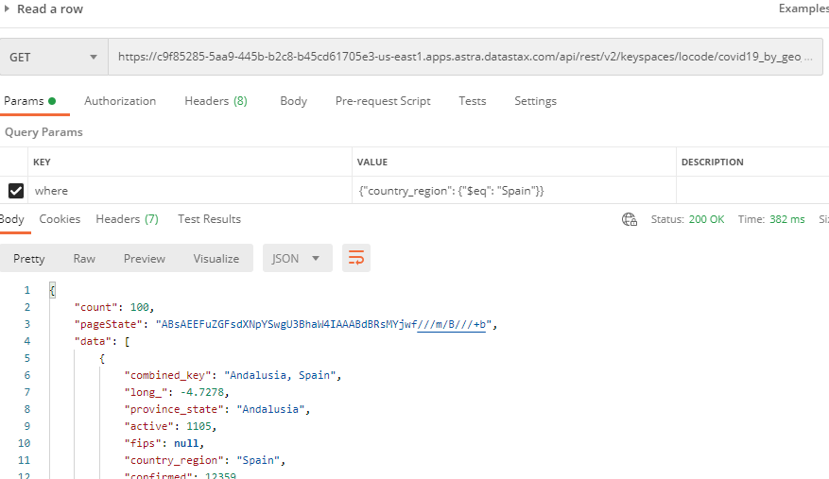
Postman: Get a row

Slide 9
BI Tool – JDBC Driver

Slide 10
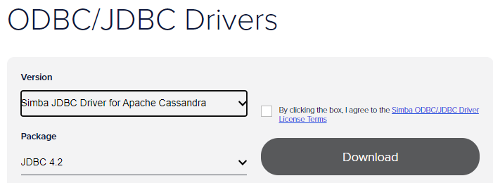
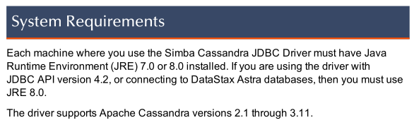
Download / Install
Review the documentation
Put a copy of the jdbc.jar file in the appropriate folder for Oracle Anaytics Desktop
C:\Program Files\Oracle Analytics Desktop\lib\CassandraJDBC42.jar

Slide 11
BI Tool – Oracle Analytics Desktop

Slide 12
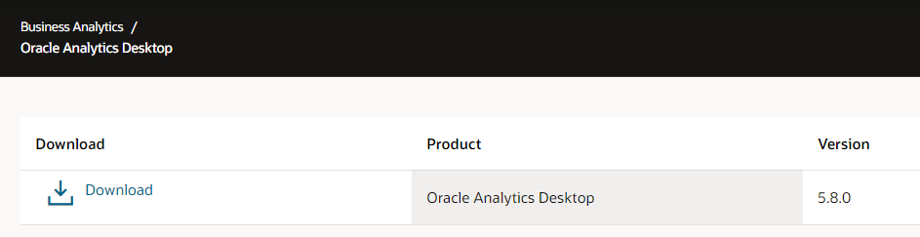
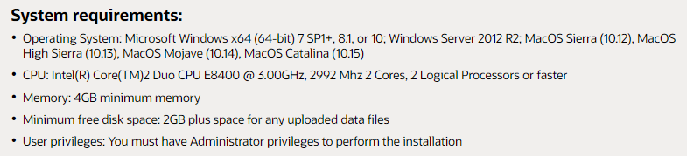
Download / Install
https://www.oracle.com/solutions/business-analytics/analytics-desktop/oracle-analytics-desktop.html

Slide 13
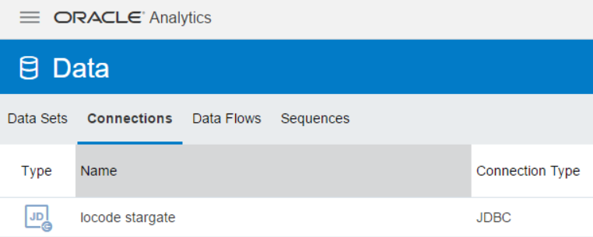
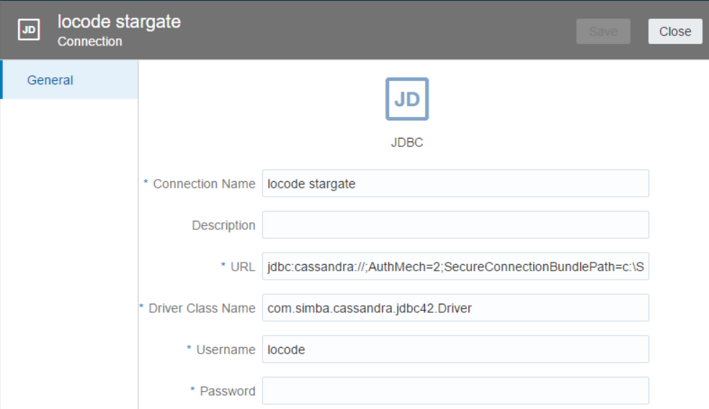
Data Connection
Property | Value
Connection Name | Any name will do … locode stargate
URL | jdbc:cassandra://;AuthMech=2;SecureConnectionBundlePath=c:\SAM\Astra\secure-connect-sams-astra-cluster.zip
Driver class name | com.simba.cassandra.jdbc42.Driver

Slide 14
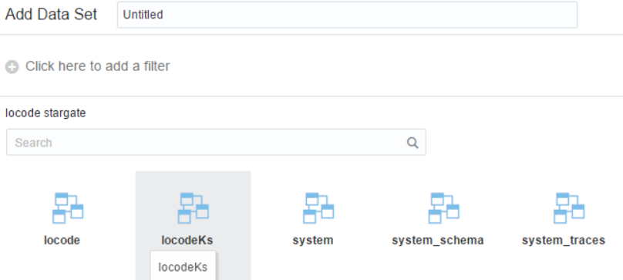
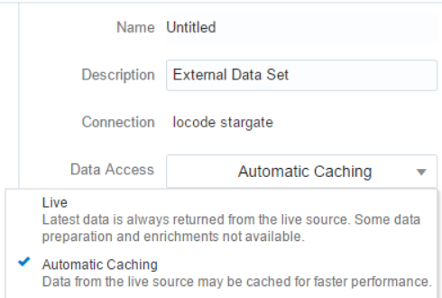
Adding Data Set
Select your keyspace (and then table/s)
Select Data Access options of Live or Automatic Cachine

Slide 15
Adding Data Set
Select your keyspace (and then table/s)
Select Data Access options of Live or Automatic Cachine
Select columns and do some “prep”
Optional: add various lookup/enrichment data per Country and/or State

Slide 16
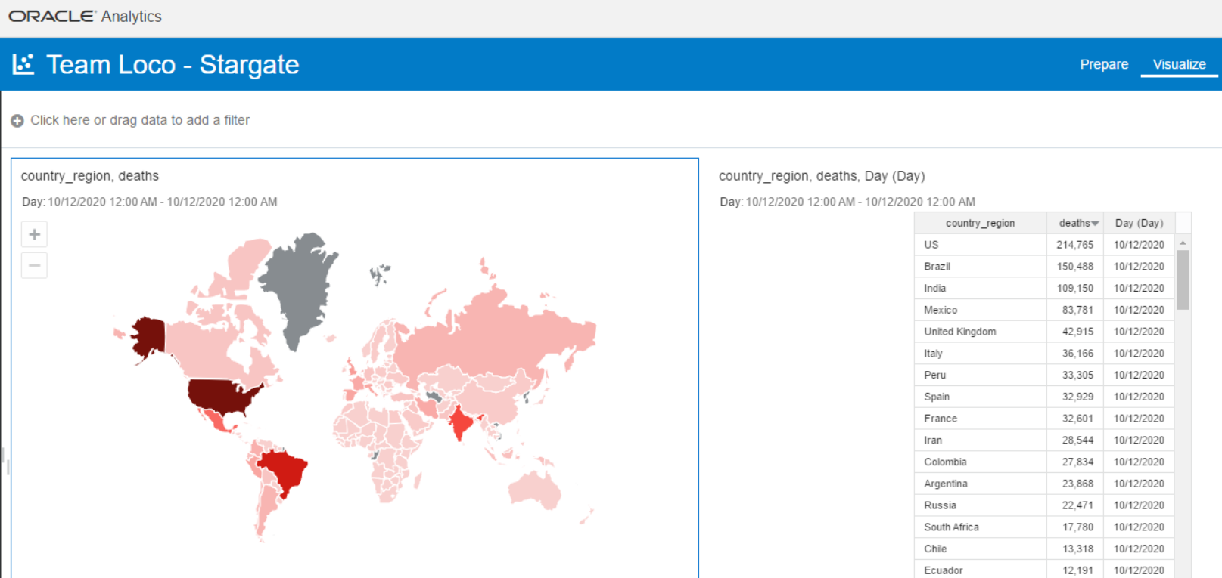
Sample Data Visualizations By Country

Slide 17
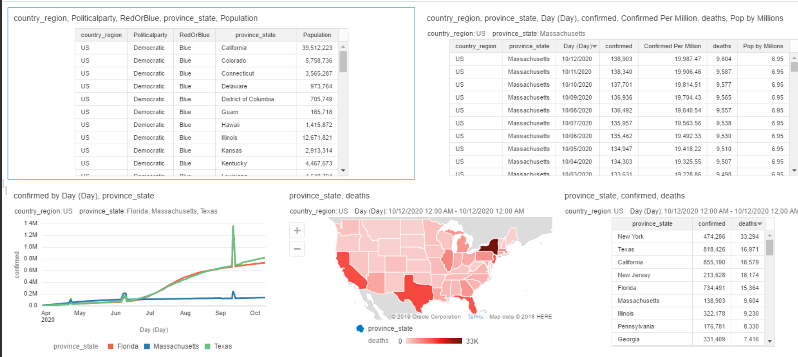
Sample Data Visualizations for the US

Slide 18
REST API with Python

Slide 19
Retrieve data using REST API interface
Usage:
python3 locodeRows.py arg1 arg2
e.g. python3 locodeRows.py Bangladesh Malaysia

